Slide 1
IPR: COMMERCIALIZATION AND UNFAIR COMPETITION

Slide 2
BRIEF OUTLINE
Introduction
Commercialization
Some Instances
Unfair Competition
Concluding Remarks

Slide 3
INTRODUCTION
Commercialization is a process which introduces a new product or technique of production to the market
Intellectual Property is not only a legal asset, but it has also a commercial value
Commercial benefits of an IPR can be extracted through selling, licensing or setting up own commercial venture
Rapid technological progress and globalization has commercialized the IP

Slide 4
COMMERCIALIZATION OF IP
Innovation process inculcate technology and inventions and are essential for transforming inventions into profitable marketable products
However, the process is complex and entails to a large extent, specialized efficiency, skills and professional knowledge
For the success of any invention and innovation (intellectual property), the ultimate and critical stage of the innovation process is the marketing and commercialization

Slide 5
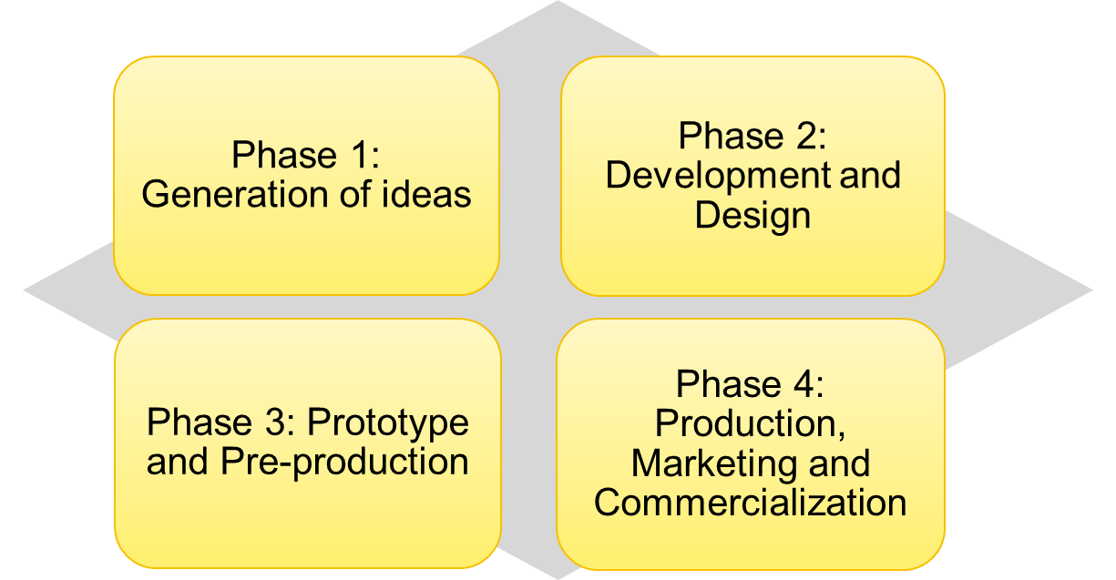
PHASES OF COMMERCIALIZATION
Source: WIPO

Slide 6
COMMERCIALIZATION STRATEGY
1 | Set up personal manufacturing and marketing
2 | Authorize others through licenses
3 | Sell the patent rights
4 | Any amalgamation of the above

Slide 7
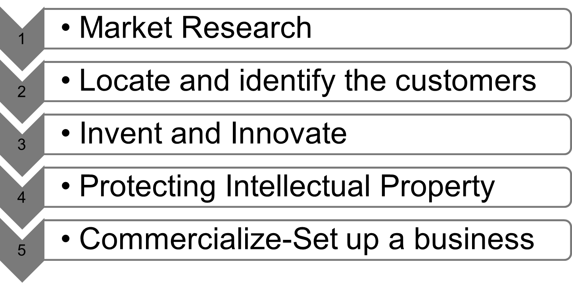
PROCESS OF COMMERCIALIZATION

Slide 8
COMMERCIALIZATION OF PATENTS
Patents are extensively created means that promote innovation
This IPR grants the holder the limited right of exploitation and allows them to venture the invention by manufacturing, using, or selling products or processes incorporating the technology covered by the patent
The owner may also allow the invention to be exploited by others over a set period of time, in return for fair reward to recoup for the R&D costs and others

Slide 9
PATENT SOME FACTS
      According to Ted Sichelman (Commercializing Patents, Stanford Law Review, 2010), about more than 50% of all the patents granted for inventions are never commercially exploited in the US
      IBM was granted approximately 67,000 US patents during 1993-2012
      It has received 6,478 patents in 2012, outpacing the aggregate of Accenture, EMC, Amazon, Intel, Apple, Oracle, Symantec, and HP
      IBM owns about 50000 active patents, which makes it one of the largest patent owner company in the world

Slide 10
PATENT: STATISTICS
Table 1: Number of Patents Granted by US Patent and Trademark Office
Origin | 2010 | 2011 | 2012 | 2013 | 2014 | 2015
U.S. And Foreign Origin | 219614 | 224505 | 253155 | 277835 | 300677 | 298407
U.S. Origin | 107791 | 108622 | 121026 | 133593 | 144621 | 140969
Foreign Origin | 111823 | 115883 | 132129 | 144242 | 156056 | 157438
Source: http://www.uspto.gov/web/offices/ac/ido/oeip/taf/cst_utl.htm

Slide 11
VALUE OF COMMERCIALIZATION
The importance of commercial value of intellectual property can be sighted through recent example of the movie in India , ‘Udta Punjab’
On 15th June 2016 , a copyright theft case with the Mumbai Police’s cybercrime was filed due to the leak of movie on internet before the proper formal release

Slide 12
OTHER INTELLECTUAL PROPERTY
Other intellectual properties appear to be very significant when successful innovation comprises captivating a new product to the market
For the marketing process industrial designs and trademarks play a critical role
However, for launching new products in the market, a trademark is an effective tool

Slide 13
COMMERCIALIZATION OF IP: SOME INSTANCES
Trademarks can be extremely successful in exploring, penetrating and entering into new markets for products
For instance, Honda captured the advantage of its brand name in motorcycle manufacturing to penetrate the United States car market
Combination of various types of IP tools such as patents, industrial designs and trademark can be traced by the example of the vacuum cleaner that offers a good case of commercialization of different intellectual properties

Slide 14
SOME INSTANCES…
Trademarks can also assist in enlarging the commercial benefits outside the life of a patent
The example may be the Aspirin® , which was developed by Felix Hoffman in 1897 while working for Bayer Company in Germany and was patented in 1899
Since, patents are granted for a limited period, the Bayer Company resorted in endorsing a trademark for its new drug
After the expiry of the patent, Bayer started benefitting from the selling of aspirin by trademark Aspirin®
The Company has also exploited the dual-way intellectual property strategy, for its Cipro® drug (used in the cure of infections).

Slide 15
SOME INSTANCES…
Intellectual property may be separately or any combination of patents, industrial designs, trade secrets, copyright or trademarks can be used to assist the commercialization of any new product
Higher profits, premium price, or significant market share can be sustained through strategic use of a combination of intellectual property tools

Slide 16
UNFAIR COMPETITION
Paris Convention (1883), Article 10 bis categories unfair competition into:
Confusion causing acts
Damaging reputation
Misleading acts
For more details follow the links: http://www.wipo.int/treaties/en/text.jsp?file_id=288514#P213_35515

Slide 17
UNFAIR COMPETITION…
Any action or practice taken out in the way of industrial or commercial enterprise opposed to honest practices is regarded as the act of unfair competition
‘contrary to honest practices’ has become the crucial criterion for defining unfair competition

Slide 18
UNFAIR COMPETITION…
Thus, the Paris Convention (1883) safeguards a member against unfair competition by making it binding for the other members
This commitment is underlined by Article 2 of the TRIPS and obligates members of the WTO to abide by the Paris Convention

Slide 19
COMPETITION LAW: PROMOTING FAIR COMPETITION
The competition law aim at prohibiting the strategy of the firms and big corporations to reduce competition and monopolizing the markets. Three broad laws are:
(i) Anti-monopoly law
(ii) Anti-collusion law (cartels, etc.)
(iii) Non-competitive merger control law

Slide 20
CONCLUSION
Converting an invention or innovation into a marketable (commercialization ) product, involves the strategy of due thoroughness which aim at recognizing significant legal and commercial risks, and application for and acquiring of the proper selection of IPRs
It also requires formation of a strong business organization and a system of license agreements with potential investors, manufacturers and distributors
Robust IPR protection ensures entrepreneurs to commercialize by cooperating rather than competing with others.
Intellectual property rights are essential for encouraging innovation, but it can create monopoly, though competition law combats it.

Slide 21
FURTHER READINGS
Video link on Commercialization of Patents: https://www.youtube.com/watch?v=TBtj3qCNkpQ
Protection Against Unfair Competition: http://www.esa.int/About_Us/Law_at_ESA/Intellectual_Property_Rights/Protection_against_unfair_competition

Slide 22
THANK YOU

